Slide 1
DALAC
Workspace Management System
David Luco, Anita Sharma, Collin Sullivan, Amanda Ali, Luke Stigdon

Slide 2
Overview
This goal of this project is to provide the following benefits:
More efficient utilization of office space
Reduce costs spent on new spaces that are unnecessary
Increase employee productivity through work environment flexibility

Slide 3
Interface Design Prototypes

Slide 4
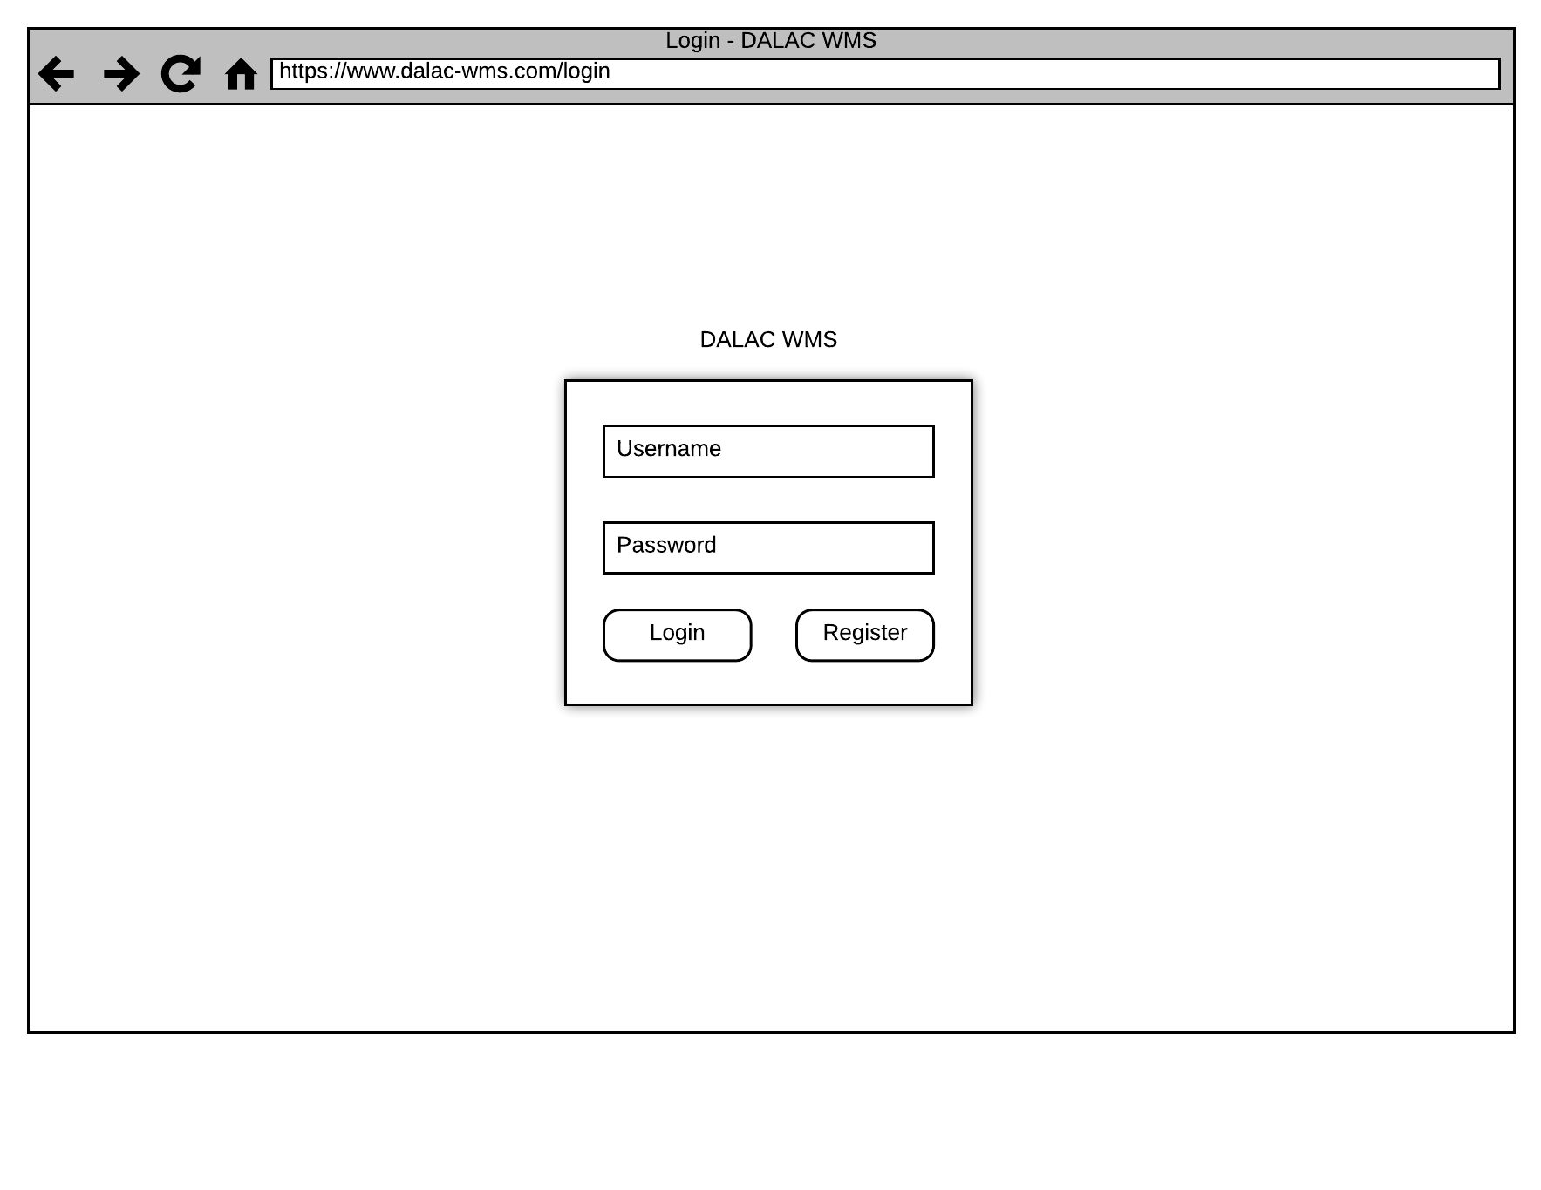
Prototype 1

Slide 5
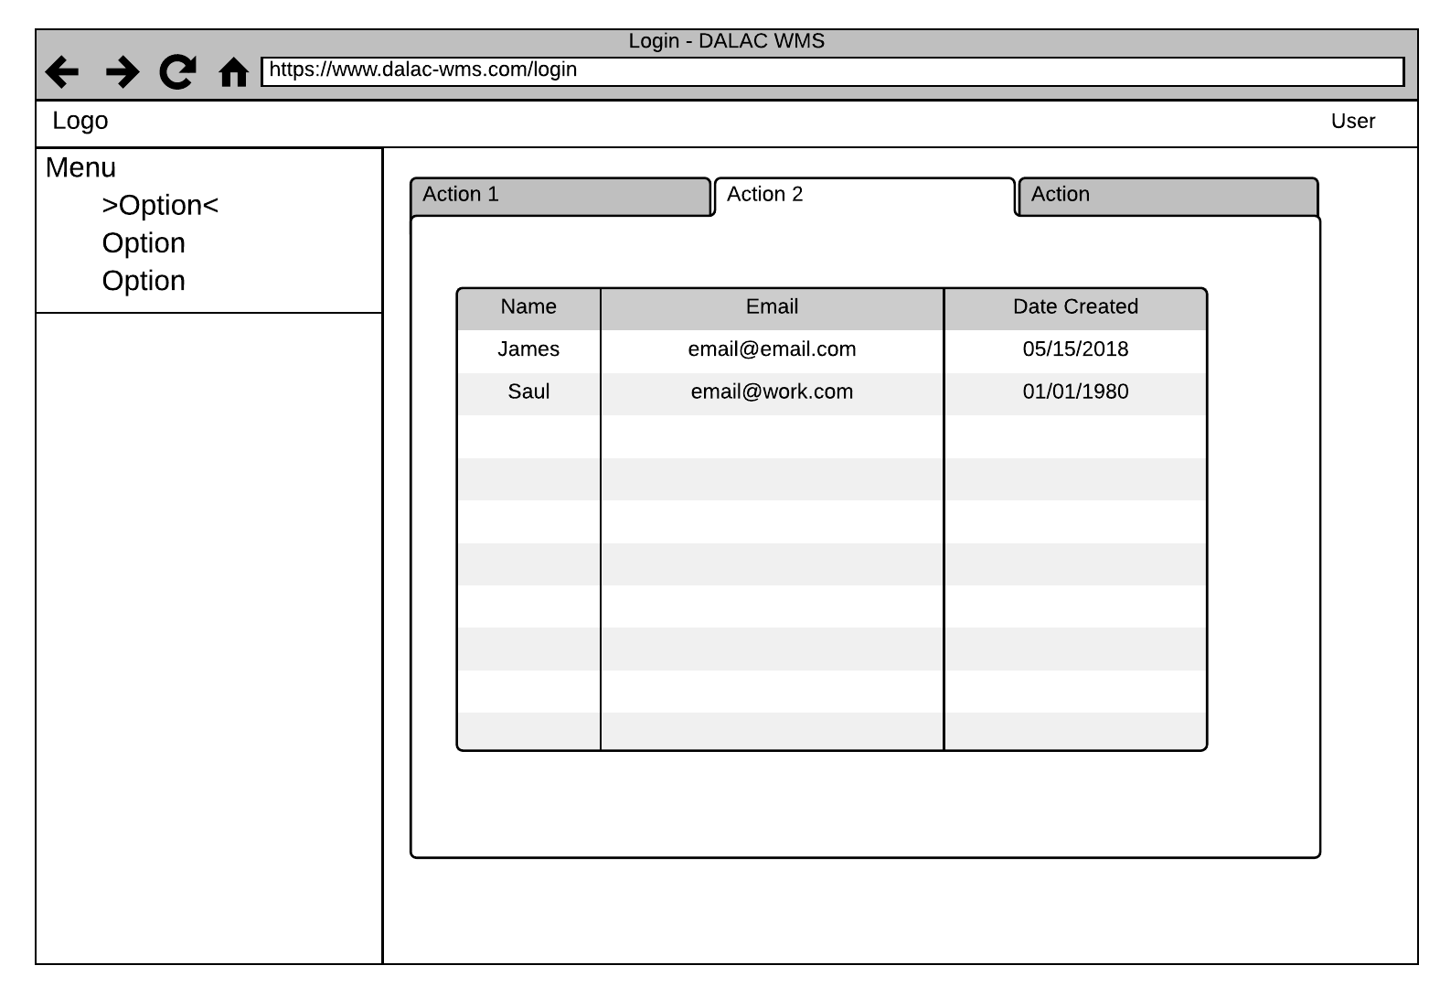
Prototype 2

Slide 6
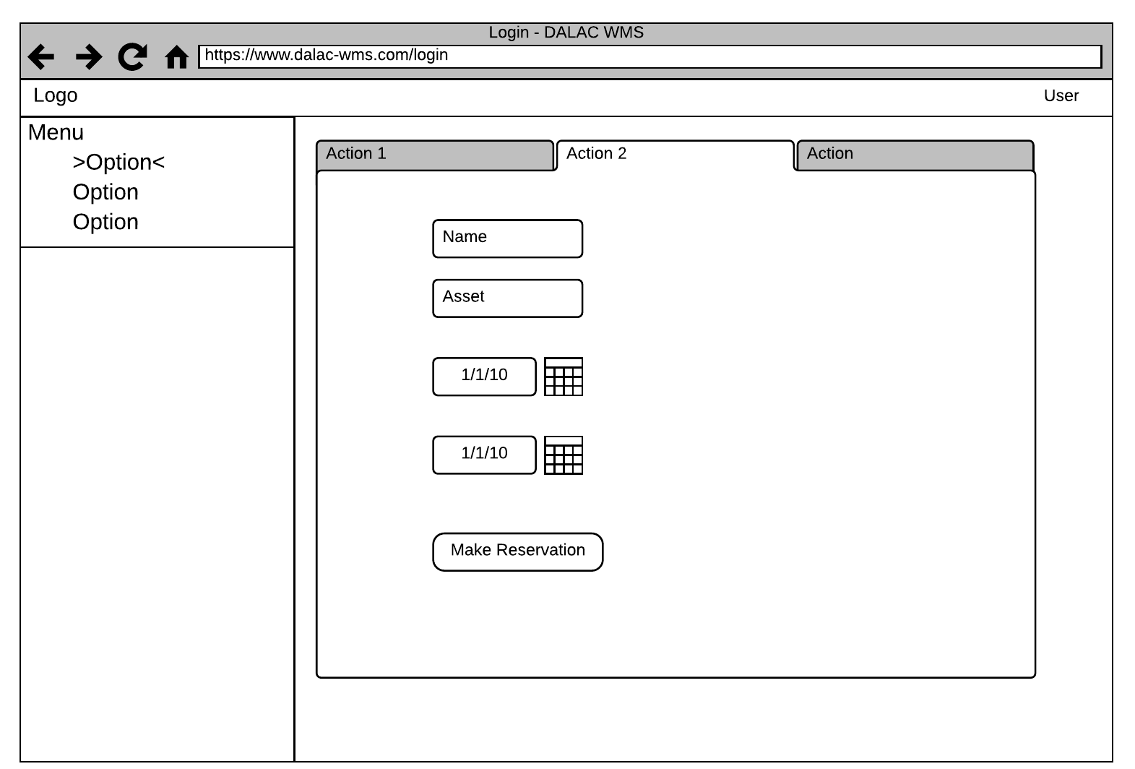
Prototype 3

Slide 7
Interface Standards

Slide 8
Interface Standards
Maintain consistent functionality throughout the sight
Use clean sans-serif fonts and contrasting colors to improve readability
Build interface with a well supported front end framework (e.g. bootstrap, react, bulma)

Slide 9
Program Design

Slide 10
Requirements to Implement Project
Based on use cases there were several key pieces of functionality were required
Create and delete users
Create and delete assets
Create and delete reservations
A minimum viable product was built using PHP to test use cases and the interface standards
The application is very lightweight and can be run on a small web server or hosted by a cloud provider at minimal cost (in some cases FREE)

Slide 11
Demo

Slide 12
Team Experiences
Challenging to have a multitude of ideas for each SDLC process and organize everything
Solved this by making sure each member followed the kanban, project timeline, and requirements of each deliverable
Learned a lot about group communication and collaboration
Would communicate clearly with team members whenever one of us needed help or was unsure about a tasks
The entire SDLC project gave a valuable insight to how the process works in the real world

Slide 13
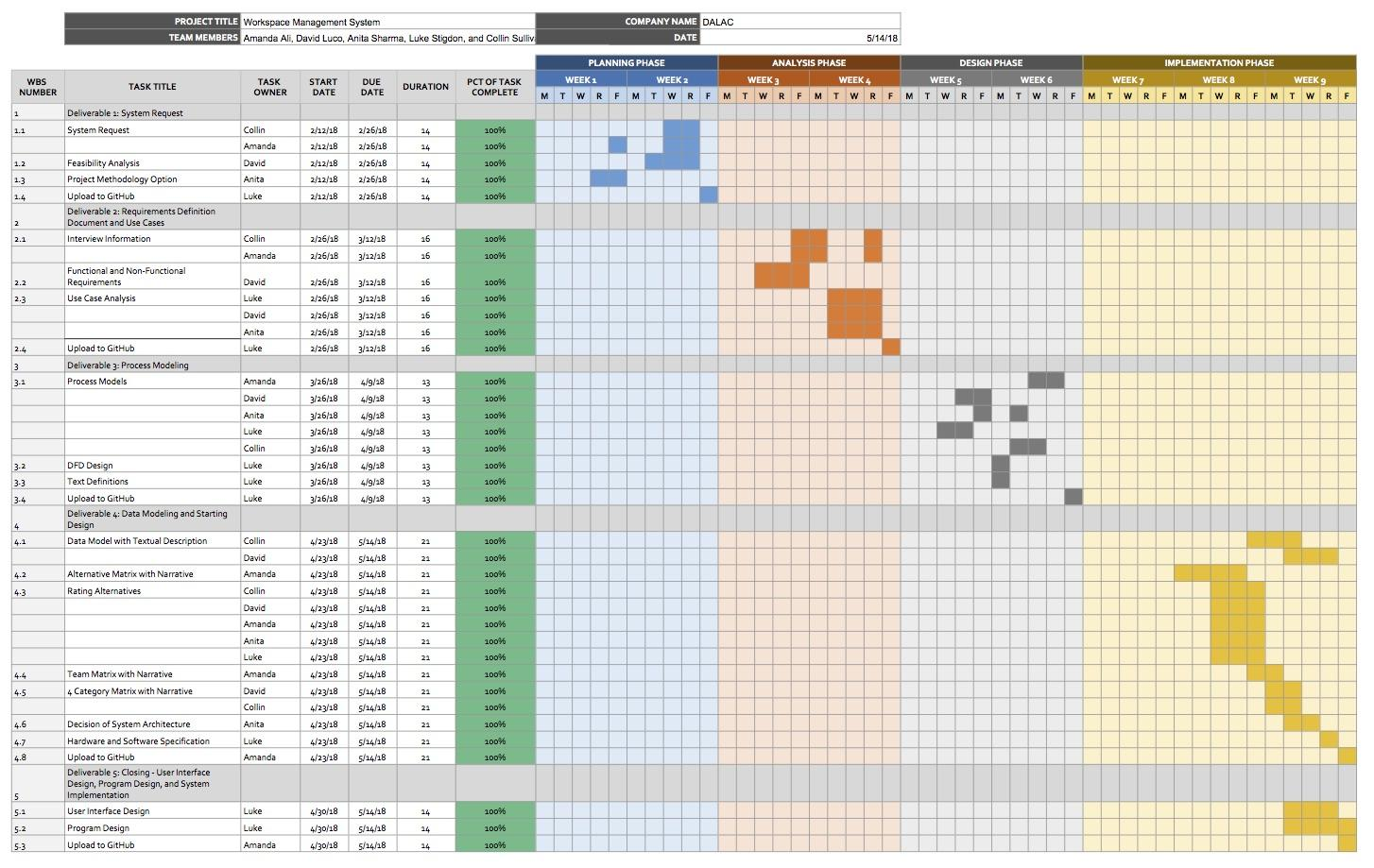
Updated Project Plan

